Slide 1
Atlantic Beach Elementary PTA

Slide 2
atlanticbeachpta.org
Mission: To make every child’s potential a reality by engaging and empowering families and communities to advocate for all children.

Slide 3
Volunteering
It has been proven that volunteering at your child’s school leads to smarter, stronger students more capable of handling the pressures of today’s modern world.
Whether it be at front and center, in the classroom, at an event, during a program, behind the scenes, or somewhere out in the garden! ABE PTA has a place where you can plug in and connect to a fantastic network of families who truly care and advocate for all the children at ABE.

Slide 4
PTA Executive Board Members
atlanticbchpta@gmail.com

Slide 5
Program and Committee Chairs
We lovingly call this
“The Zoo”
Areas of immediate need:
BULLETIN BOARD
MARQUEE
GRANT WRITING
GREEN TEAM
MEMBERHUB
ONLINE STORE

Slide 6
Membership
Individual membership
is only $5
(online $6)
Consider signing up
as a business member
and get exposure
with nearly
500 students and families!

Slide 7
Business Partner Membership
Sponsorships are available for
Dolphin Fest
(formerly known as Basket Blast!)
Contact Lindy Mullen for details.

Slide 8
2019-2020
ABE PTA
Business Partners
Thank you!!
We couldn’t do
everything we wanted
to do without
your support.

Slide 9
Green Team
New computers for the lab
Fuel Up to Play 60

Slide 10
https://abedolphins.memberhub.com
One stop, multifaceted communication and compliance tool for PTA’s across the state of Florida.

Slide 11
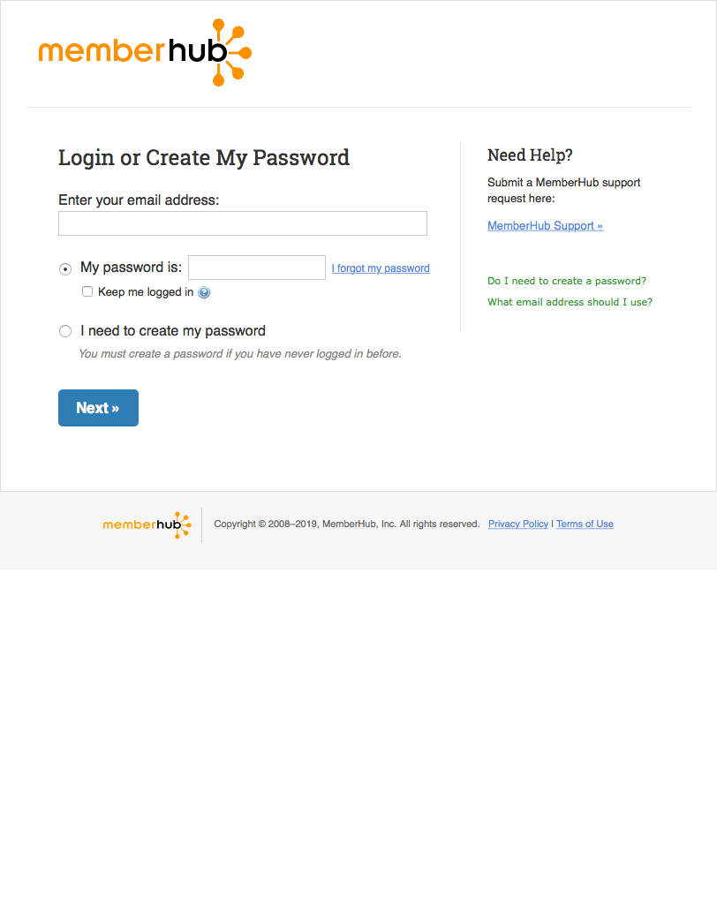
Create your login

Slide 12
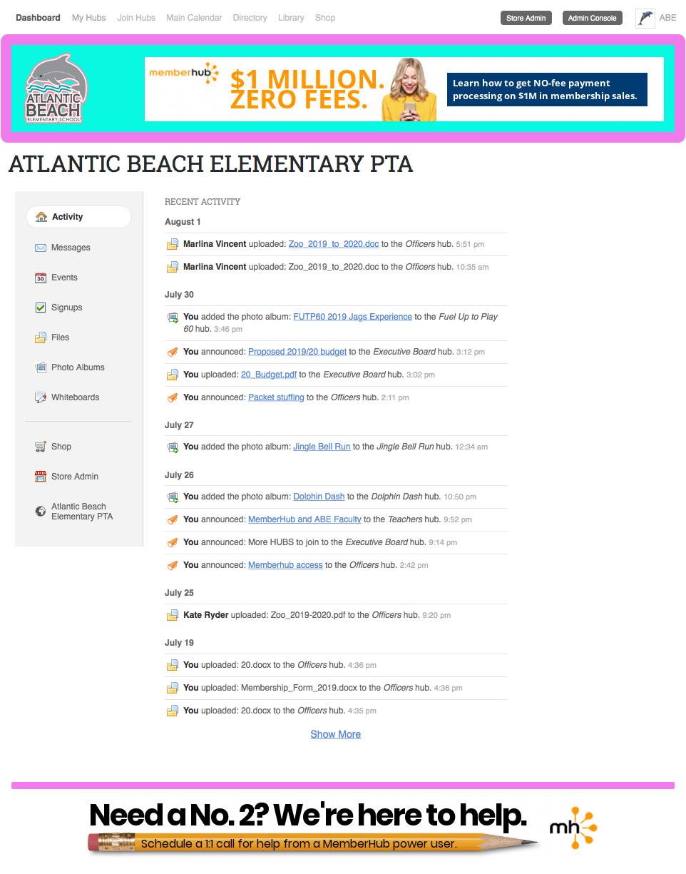
HERE—->
Main pages
<—————————————HERE
INFO and
COMMUNICATION
HERE—->
this will take you directly to our website and online store

Slide 13
 | Executive Board | 7 people
 | Officers | 14 people
 | PTA E-Newsletter List 2018-2019 (fifth grade purged) | 365 people
 | PTA E-Newsletter List 2019-2020 | 5 people
 | PTA Fundraising | 7 people
 | ↳ Box Tops | 3 people
 | ↳ Dolphin Fest (formerly: Basket Blast) | 5 people
 | PTA Programs | 8 people
 | ↳ Book Fair | 2 people
 | ↳ Dolphin Dash | 3 people
 | ↳ Fuel Up to Play 60 | 3 people
 | ↳ Gardening | 1 person
 | ↳ Jingle Bell Run | 2 people
 | Teachers | 42 people
 | ↳ 1st grade | 0 people
 | ↳ 2nd grade | 0 people
 | ↳ 3rd grade | 0 people
 | ↳ 4th grade | 0 people
 | ↳ 5th grade | 1 person
 | ↳ Kindergarten | 0 people
 | ↳ VPK and Pre-K | 0 people
“HUBS”
***
***
These are the current hubs that have been created but more
can be added based on the needs of organizing our volunteers and announcing relevant PTA and school news.

Slide 14
Boo-HOO Yah-HOO Breakfast!
Happy or sad come join us in the media center on Monday, August 12th at 8:30am
First PTA General meeting
Meet the Board, learn about our programs and the great things going on at ABE!
Make friends that will last a lifetime

Slide 15
T-shirts,
Totes,
and Tumblers provided by PTA
T-shirt and totes can be purchased online.
Tumblers will be available for purchase at Orientation.

Slide 16
atlanticbeachpta.org
“Grains 4 Brains”
http://abedolphins.memberhub.com

